Slide 1
DevOps Foundations: Version Control and CI/CD with Jenkins

Slide 2
Entering the World of DevOps

Slide 3
Apply DevOps concepts to improve collaboration between development and operations teams, enhancing software quality and deployment frequency
Comprehend how DevOps and Agile methodologies work together in software development to enhance project flexibility and speed up the product release cycles
Identify the key aspects of how to transition from traditional approach to DevOps for software development
Utilize DevSecOps approaches to build a secure CI/CD pipeline
Notes:
Mode: Sync
Estimated duration: 2 minutes
Type: Instructor-led
Instructor Note:
State the learning objectives of the lesson.

Slide 4
Getting Started with DevOps
Notes:
Instructor Notes:
Let us now get started with DevOps

Slide 5

What Is DevOps?
It is a software development practice or mindset that promotes collaboration between development
and operations.
PLAN
DEPLOY
CODE
OPERATE
Dev
Ops
BUILD
RELEASE
TEST
MONITOR
The aim of DevOps is to optimize the development cycle and ensure continuous delivery of high
quality software reducing the time to market.
Notes:
Instructor Notes:
DevOps is an evolving philosophy and framework that encourages faster, better application development and faster release of new or revised software features or products to customers.
The practice of DevOps encourages smoother, continuous communication, collaboration, integration, visibility, and transparency between application development teams (Dev) and their IT operations team (Ops) counterparts.
This closer relationship between “Dev” and “Ops” permeates every phase of the DevOps lifecycle: from initial software planning to code, build, test, and release phases and on to deployment, operations, and ongoing monitoring. This relationship propels a continuous customer feedback loop of further improvement, development, testing, and deployment. One result of these efforts can be the more rapid, continual release of necessary feature changes or additions.

Slide 6
Benefits of DevOps
Speed
Efficiency
Communication
Reliability
Increases workflow speed resulting in reduction of time-to-market
Streamlines transitions of stages of lifecycle and task management in the pipeline
Enhances team collaboration via a centralized system
Helps achieve consistent project delivery by a robust infrastructure
Notes:
Instructor Notes:
Speed: DevOps accelerates workflow speed, enhancing response time and deployment efficiency.
Efficiency: Improved efficiency in transitions and task management leads to smoother operations in the DevOps pipeline.
Communication: Enhanced communication within teams fosters better collaboration and outcomes in software development.
Reliability: Increased reliability ensures consistent delivery of projects, meeting deadlines and requirements.

Slide 7
Benefits of DevOps
Quality
Consistency
Agility
Adaptability
Helps in continuous improvement of project quality through iterative enhancements
Promotes consistency in workflow and results through iterations
Responds proactively to changes and enhances planning effectiveness
Ensures efficient real-time response to changes and issues
Notes:
Instructor Notes:
Quality: DevOps naturally enhances project quality through iterative improvements and pain point resolutions.
Consistency: The iterative nature of DevOps promotes consistency in workflow and results.
Agility: Agility enables proactive responses to changes, saving time and enhancing planning effectiveness.
Adaptability: Adaptability ensures organizations can respond effectively to real-time changes and issues in the DevOps process.

Slide 8
DevOps Principles
Collaboration
Automation
Establish a collaboration between the development and operations team
Automate processes and increase productivity
Continuous
improvement
Customer-centric
action
Understanding
customer needs
Experiment, minimize waste, and optimize delivery through iterations
Prioritize customer feedback and response through continuous monitoring
Create products and services centered around user needs
Notes:
Instructor Notes:
Collaboration: Development and operations teams merge into a functional team, leading to full-stack development and ownership of projects from idea to delivery.
Automation: DevOps focuses on automating software development processes, reducing errors, and increasing team productivity through CI/CD pipelines.
Continuous Improvement: DevOps practices include continuous experimentation, waste minimization, and optimization for speed, cost, and delivery ease.
Customer-centric Action: DevOps teams prioritize short feedback loops with users, enabling rapid response to feedback and real-time monitoring for further improvements.
Create with the End in Mind: DevOps teams understand customer needs and create products and services that solve real problems, avoiding assumptions and ensuring a holistic product understanding.

Slide 9
Traditional Approach
To understand why one should choose DevOps, we need to get the understanding of the traditional approach of development.
The traditional software development approach (waterfall method) has a sequence of activities for system designers and developers to plan, create, test, and deploy a software system.
Requirements
Design
Implementation
Testing
Deployment
Maintenance
Notes:
Instructor Notes:
The waterfall method is a traditional approach to software development that follows a linear, sequential order. It's often visualized as a cascade falling down a cliff, where each stage feeds into the next. Here's a breakdown of the waterfall method's phases:
Requirements Gathering and Analysis: This initial phase involves collecting requirements from stakeholders (clients, users, etc.) to understand the project's goals and functionalities. A detailed requirements specification document is created to ensure everyone is on the same page.
Design: With the requirements defined, the system architecture and design are created. This involves defining how the software will be structured and the technologies used.
Implementation (Coding): Once the design is finalized, developers start building the software based on the specifications and design documents.
Verification and Testing: After development, the software undergoes rigorous testing to identify and fix bugs and ensure it meets the requirements.
Deployment: The final product is deployed to the production environment where it will be used by the end users.
Maintenance: Even after deployment, the software needs ongoing maintenance to fix issues, address new requirements, and adapt to changes.
The waterfall method is most suitable for projects with well-defined requirements that are unlikely to change significantly during development. It can be effective for projects with clear goals, stable technologies, and limited user interaction. However, in today's dynamic software development landscape, more agile methodologies are often preferred to accommodate evolving requirements and provide for earlier user feedback.

Slide 10
Challenges in the Traditional Approach
Using traditional methods poses major challenges in development due to their drawbacks.
Rigidity in process
Blocks adjustments to project needs or market changes, causing expensive revisions
Long time to market
Impacts fast-paced industries and traditional phased development that delays market entry
Notes:
Instructor Notes:
Rigidity in Process: Traditional software development methodologies are often linear and sequential. This rigidity can make it difficult to adapt to changes in project requirements or market conditions. Once a phase is completed, revisiting or modifying it can be costly and time-consuming.
Long Time to Market: Due to the phased approach of traditional development, it often takes a long time to deliver the final product. This can be a significant disadvantage in industries where speed and agility are critical for staying competitive.

Slide 11
Challenges in the Traditional Approach
Using traditional methods poses major challenges in development due to their drawbacks.
Difficulty in handling changes
Encounters development disruptions, leading to delays and higher costs
Limited customer feedback
Delays in traditional development hinder user feedback, compromising product effectiveness
Notes:
Instructor Notes:
Difficulty in Handling Changes: Traditional methods are not designed to accommodate changes once the development has begun. Changes in customer requirements, technology, or market dynamics can disrupt the entire project flow, leading to delays and increased costs.
Limited Customer Feedback: In traditional development, significant features or the whole system are only available for customer feedback after many stages of development. This limits opportunities for incorporating user feedback and may result in a product that doesn't meet user needs effectively.

Slide 12
Traditional Approach vs. DevOps
Aspect | Traditional Approach | DevOps
Focus | Improves infrastructure only | Improves infrastructure and application
Speed | Slower recovery and releases | Faster recovery and releases
Development model | Linear model | Continuous integration and deployment
Teamwork | Focuses on specific functions without cross-team collaboration | Emphasizes a collaborative approach where different teams work together
Notes:
Instructor Notes:
The slide presents a comparison between the Traditional Approach and DevOps across four aspects: Focus, Speed, Development Model, and Teamwork.
Aspect: Focus
Traditional Approach: Emphasizes improvements in infrastructure only.
DevOps: Aims to improve both infrastructure and application, highlighting a broader scope of enhancement.
Aspect: Speed
Traditional Approach: Characterized by slower recovery and release processes.
DevOps: Known for faster recovery and release processes, indicating higher efficiency and responsiveness.
Aspect: Development Model
Traditional Approach: Follows a linear development model, which might imply a more sequential and rigid process.
DevOps: Utilizes continuous integration and deployment, suggesting a more iterative and flexible development cycle.
Aspect: Teamwork
Traditional Approach: Focuses on specific functions without cross-team collaboration, potentially leading to silos.
DevOps: Emphasizes a collaborative approach where different teams work together, promoting a culture of shared responsibility and teamwork.

Slide 13
Adopting DevOps Model
Here are the concepts or best practices required to adopt DevOps:
Continuous integration
Merging multiple code changes into a central repository to allow developers to improve software quality
Continuous delivery
Automating building, testing, and deployment of code for feature releases
Monitoring and logging
Monitoring application performance and logs for proactive issue detection and resolution
Notes:
Instructor Notes:
Continuous Integration: Continuous integration is a software development practice where developers regularly merge their code changes into a central repository, after which automated builds and tests are run. The key goals of continuous integration are to find and address bugs quicker, improve software quality, and reduce the time it takes to validate and release new software updates.
2. Continuous delivery: Continuous delivery is a software development practice where code changes are automatically built, tested, and prepared for a release to production. It expands upon continuous integration by deploying all code changes to a testing environment and/or a production environment after the build stage. When continuous delivery is implemented properly, developers will always have a deployment-ready build artifact that has passed through a standardized test process.
3. Monitoring and Logging: Organizations monitor metrics and logs to see how application and infrastructure performance impacts the experience of their product’s end user. By capturing, categorizing, and then analyzing data and logs generated by applications and infrastructure, organizations understand how changes or updates impact users, shedding insights into the root causes of problems or unexpected changes. Active monitoring becomes increasingly important as services must be available 24/7 and as application and infrastructure update frequency increases. Creating alerts or performing real-time analysis of this data also helps organizations more proactively monitor their services.

Slide 14
Adopting DevOps Model
Infrastructure
as Code (IaC)
Managing infrastructure using code to enable scalable and consistent deployments
Designing applications as small and independent services for flexibility, scalability, and isolated deployment
Microservices
Communication and
collaboration
Fostering teamwork and communication between teams for efficient project delivery and alignment
Notes:
Instructor Notes:
4. Infrastructure as Code: Infrastructure as code is a practice in which infrastructure is provisioned and managed using code and software development techniques, such as version control and continuous integration. The cloud’s API-driven model enables developers and system administrators to interact with infrastructure programmatically, and at scale, instead of needing to manually set up and configure resources. Thus, engineers can interface with infrastructure using code-based tools and treat infrastructure in a manner similar to how they treat application code. Because they are defined by code, infrastructure and servers can quickly be deployed using standardized patterns, updated with the latest patches and versions, or duplicated in repeatable ways.
5. Microservices: The microservices architecture is a design approach to build a single application as a set of small services. Each service runs in its own process and communicates with other services through a well-defined interface using a lightweight mechanism, typically an HTTP-based application programming interface (API). Microservices are built around business capabilities; each service is scoped to a single purpose. You can use different frameworks or programming languages to write microservices and deploy them independently, as a single service, or as a group of services.
6. Communication and Collaboration: Increased communication and collaboration in an organization is one of the key cultural aspects of DevOps. The use of DevOps tooling and automation of the software delivery process establishes collaboration by physically bringing together the workflows and responsibilities of development and operations. Building on top of that, these teams set strong cultural norms around information sharing and facilitating communication through the use of chat applications, issue or project tracking systems, and wikis. This helps speed up communication across developers, operations, and even other teams like marketing or sales, allowing all parts of the organization to align more closely on goals and projects.

Slide 15
Assisted Practice
Duration: 15 Min.
Implementing the DevOps model
Problem statement:
You have been assigned a task to implement DevOps using GitHub to store a Java program and Jenkins to build consistent code packages, enabling continuous integration and continuous deployment.
Outcome:
By completing this demo, you will be able to gain proficiency in implementing a CI/CD pipeline by creating a GitHub repository, adding a Java program, setting up a Jenkins freestyle build job, and automating the build process for continuous integration and deployment.
Note: Refer to the demo document for detailed steps
Notes:
Instructor Notes:
Refer to the demo document for detailed steps

Slide 16
Assisted Practice: Guidelines
Steps to be followed:
Create a GitHub repository
Add a Java program to the repository
Create a freestyle build job in Jenkins
Build the Java program with Jenkins
Notes:
Instructor Notes:
Refer to the demo document for detailed steps

Slide 17
As an IT manager leading an online music streaming application, you are considering adopting DevOps practices. How would you explain the major difference between DevOps and the traditional approach?
DevOps emphasizes separate teams for development and operations.
DevOps focuses on manual software deployment.
DevOps promotes automation, collaboration, and continuous integration and deployment.
DevOps results in slower software delivery compared to the traditional approach.
Notes:
Mode: Sync
Estimated duration: 5 minutes
Instructor Notes:
Conduct the poll and, if necessary, reteach key points based on the results before starting with the next topic.
Provide feedback or explanations after the poll, where appropriate, so learners can understand why certain answers are correct or incorrect.
If most of the class is getting the poll incorrect, then there is a gap in their understanding. Prompt the learners to highlight which concepts are unclear to them and teach those topics for the understanding of the whole class. Move onto the next topic when the class is confident in their understanding of the section.
Correct Answer: C) DevOps promotes automation, collaboration, and continuous integration/deployment.
Explanation: DevOps differs from the traditional approach by promoting automation, collaboration, and continuous integration/deployment, resulting in faster and more reliable software delivery.

Slide 18
Agile and DevOps
Notes:
Instructor Notes:
Let us now get started with DevOps

Slide 19
What Is Agile?
Agile is another popular framework or approach towards optimizing SDLC.
It is an iterative development process that promotes continuous iteration of development and testing throughout the project lifecycle.
Evolution
Requirement analysis
Agile Model
Testing
Design
Implementation
Notes:
Instructor Notes:
Agile model is a combination of iterative and incremental process models with focus on process adaptability and customer satisfaction by rapid delivery of working software product. Agile Methods break the product into small incremental builds. These builds are provided in iterations.

Slide 20
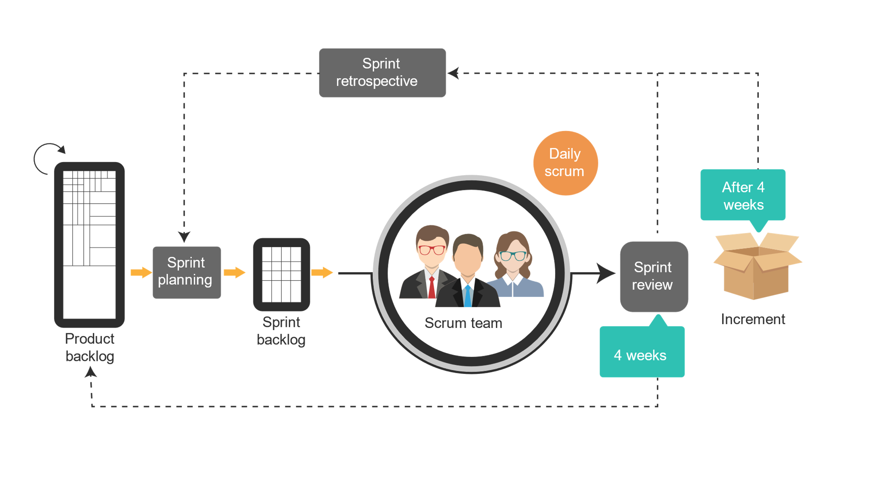
Agile Model: Example
Here is a visual representation of the Scrum methodology under Agile for project management.
Notes:
Instructor Notes:
It depicts a visual representation of the Agile Scrum methodology for project management. Here is a breakdown of the elements and their relationships:
Sprint: A fixed time interval (typically one to four weeks) where a Scrum Team works to complete a set of tasks. The diagram shows two Sprints.
Scrum Team: A cross-functional group of people accountable for delivering the product.
Product Backlog: A prioritized list of features and functionalities that the product will eventually have.
Sprint Backlog: A subset of work items from the product backlog chosen for a particular Sprint.
Sprint Planning: A meeting at the beginning of a Sprint where the Scrum Team selects work from the product backlog for the upcoming Sprint and creates a plan for completing it.
Daily Scrum: A brief daily meeting held by the Scrum Team to assess progress, identify impediments, and adapt the Sprint Backlog as needed.
Increment: The working product resulting from the completion of a Sprint.
Sprint Review: A meeting held at the end of a Sprint to showcase the Increment to stakeholders and get feedback.
Retrospective: A meeting held after the Sprint Review to discuss what went well, what could be improved, and how to improve the process for future Sprints.
The leftmost section depicts what happens Before 4 weeks. Here the product backlog is refined and prioritized.
Then, the four-week Sprint begins:
In Sprint Planning, the team selects items from the product backlog and creates the sprint backlog.
Throughout the Sprint, there are daily scrums to keep the team on track.
Development work occurs to turn the sprint backlog items into a working product.
At the Sprint Review, the completed work (the Increment) is presented to stakeholders for feedback.
Finally, in the Retrospective, the team reflects on the strengths and weaknesses of the past Sprint to improve future ones.
The Agile methodology emphasizes iterative development, where the product is built and improved in short cycles. This allows for flexibility and adaptation to changing requirements.

Slide 21
Advantages of Agile
The advantages of Agile methodologies in software development and project management include:
Interactions with stakeholders and team members
Continuous and fast delivery
Continuous attention to technical excellence and better design
Adaptation to the regular changing requirements
Continuous testing and deployment
Notes:
Instructor Notes:
Customer satisfaction by rapid, continuous delivery of useful software.
People and interactions are emphasized rather than process and tools. Customers, developers and testers constantly interact with each other.
Working software is delivered frequently (weeks rather than months).
Face-to-face conversation is the best form of communication.
Close, daily cooperation between businesspeople and developers.
Continuous attention to technical excellence and good design.
Regular adaptation to changing circumstances.
Even late changes in requirements are welcomed.

Slide 22
DevOps vs. Agile
Aspect | Agile | DevOps
Focus | Development process, iterative progress, collaboration, and customer feedback | Entire software delivery lifecycle, collaboration between development and operations
Principles | Customer collaboration, responding to change, delivering working software frequently (Agile Manifesto) | Automation, continuous integration/continuous delivery (CI/CD), monitoring, feedback loops
Practices | Scrum, Kanban, Extreme Programming (XP) | Infrastructure as code (IaC), CI/CD, automated testing, monitoring
Teams | Small, cross-functional teams including developers, testers, and business analysts | Collaboration between development, IT operations, QA, and sometimes security (DevSecOps)
Cycle | Short iterations or sprints (1-4 weeks) resulting in potentially shippable product increments | Continuous flow of code from development to production, enabling frequent and reliable releases
Goals | Deliver high-quality software quickly and respond effectively to changing requirements | Improve the speed and reliability of software delivery, ensuring high-quality software can be released quickly and safely
Notes:
Instructor Notes:
DevOps:
Promotes collaboration and automation between development and operations teams to streamline software delivery and improve deployment speed.
Focuses on continuous integration, continuous delivery, infrastructure automation, and monitoring to ensure faster, more reliable, and scalable software deployments.
Agile:
Emphasizes iterative development, customer collaboration, and faster feature delivery through short development cycles.
Utilizes frameworks like Scrum and Kanban to manage tasks, prioritize work, and adapt to changing requirements during development.

Slide 23
DevOps with Agile
Below are the key points that can be considered when DevOps is combined with Agile:
Satisfy customers through early and continuous delivery of valuable software with each sprint
Deliver working software frequently with a preference for shorter timescale and promote continuous feedback
Promote a culture of collaboration and continuous improvement
Notes:
Instructor Notes:
DevOps and Agile methodologies collaborate by promoting iterative development cycles, continuous integration and deployment practices, and fostering a culture of collaboration (Stakeholders and developers must work together throughout the project) and continuous improvement, resulting in faster delivery, improved quality, and better alignment with customer needs.

Slide 24
DevOps with Agile
Replaces non-human steps using automation tools
Improves the collaboration between the teams
Relationship between Agile and DevOps
Automates the process and development itself to create a minimal viable product incrementally
Notes:
Instructor Notes:
DevOps and Agile methodologies collaborate by promoting iterative development cycles, continuous integration and deployment practices, and fostering a culture of collaboration and continuous improvement, resulting in faster delivery, improved quality, and better alignment with customer needs.

Slide 25
As a developer, how do you see the integration of DevOps practices with Agile methodologies benefiting your project?
By emphasizing strict development timelines
By promoting collaboration between development and operations teams
By discouraging automation in the development process
By following a waterfall approach to software development
Notes:
Mode: Sync
Estimated duration: 5 minutes
Instructor Notes:
Conduct the poll and, if necessary, reteach key points based on the results before starting with the next topic.
Provide feedback or explanations after the poll, where appropriate, so learners can understand why certain answers are correct or incorrect.
If most of the class is getting the poll incorrect, then there is a gap in their understanding. Prompt the learners to highlight which concepts are unclear to them and teach those topics for the understanding of the whole class. Move onto the next topic when the class is confident in their understanding of the section.
Correct Answer: B) By promoting collaboration between development and operations teams
Explanation: Adopting the DevOps model involves emphasizing collaboration, automation, and continuous integration or deployment to enhance software development and delivery processes.

Slide 26
DevOps: Architecture, Lifecycle, and Essential Tools
Notes:
Instructor Notes:
Let us now discuss DevOps: Architecture, Lifecycle, and Essential Tools

Slide 27
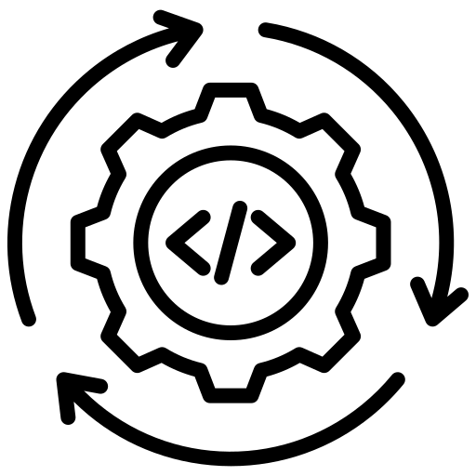


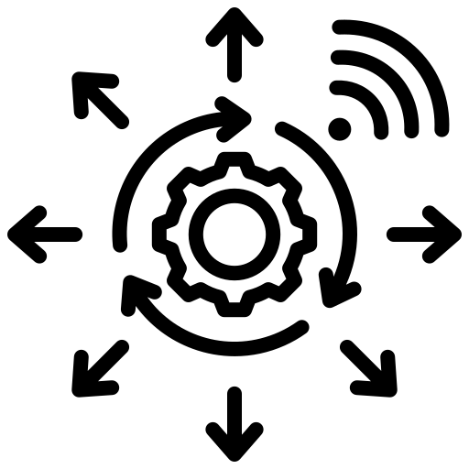
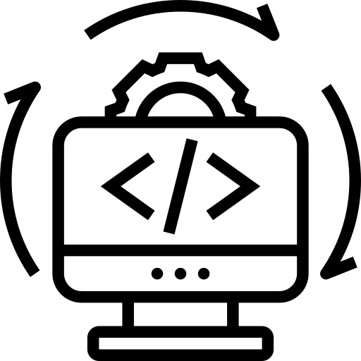
DevOps Architecture
The following architecture of DevOps depicts a flow of the execution for developing a software and managing large distributed applications efficiently:
Continuous development
Continuous monitoring
Continuous testing
Continuous deployment
Continuous integration
Notes:
Instructor Notes:
DevOps architecture facilitates hosting applications on cloud platforms and managing large distributed applications seamlessly. With DevOps services, everything from source code to team features is hosted in the cloud, accessible with just an internet connection and offering cost-effective scalability without the burden of self-hosted server management. A DevOps Architect plays a crucial role in defining and implementing the phases of DevOps Architecture for efficient application deployment and management.

Slide 28
DevOps Architecture
Continuous development
Involve continuously coding and building new features or updates for software applications
Continuous testing
Automate testing of code changes to ensure quality and identify bugs early
in the development process
Continuous integration
Merge code changes into a shared repository and perform automated
builds and tests to detect integration issues
Notes:
Instructor Notes:
This slide presents three key components of DevOps Architecture: Continuous Development, Continuous Testing, and Continuous Integration.
Component: Continuous Development
Description: Involves continuously coding and building new features or updates for software applications.
Explanation: This component emphasizes the ongoing nature of development activities in DevOps, where new code is regularly written and integrated into the application.
Component: Continuous Testing
Description: Automate testing of code changes to ensure quality and identify bugs early in the development process.
Explanation: This highlights the importance of automated testing within DevOps to maintain high quality and quickly detect issues before they reach production.
Component: Continuous Integration
Description: Merge code changes into a shared repository and perform automated builds and tests to detect integration issues.
Explanation: This component focuses on the practice of integrating code changes frequently, ensuring that any integration issues are identified and resolved quickly.

Slide 29
DevOps Architecture
Continuous deployment
Deploy code changes automatically to testing or production environments
after passing through the build and test stages
Continuous monitoring
Monitor application performance and infrastructure in real time to detect
issues, gather insights, and ensure system reliability and performance
Notes:
Instructor Notes:
This slide highlights two additional key components of DevOps Architecture: Continuous Deployment and Continuous Monitoring.
Component: Continuous Deployment
Description: Deploy code changes automatically to testing or production environments after passing through the build and test stages.
Explanation: This component emphasizes the automation of deploying code changes, ensuring that updates are delivered quickly and efficiently to the desired environment.
Component: Continuous Monitoring
Description: Monitor application performance and infrastructure in real time to detect issues, gather insights, and ensure system reliability and performance.
Explanation: This component focuses on the importance of real-time monitoring to maintain the health and performance of applications and infrastructure, allowing teams to proactively address issues.

Slide 30
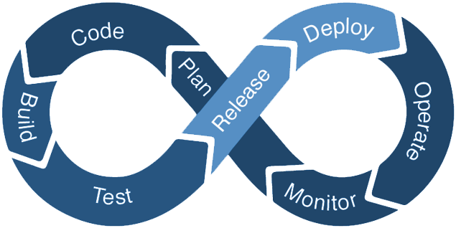
DevOps Lifecycle
It is a collaborative and iterative process, focusing on delivering software that meets the specific needs of businesses and their users through regular feedback.
Notes:
Instructor Notes:
The DevOps lifecycle, driven by collaboration and automation, ensures the delivery of high-quality software aligned with business needs. Its phases — planning, coding, testing, deployment, monitoring, and feedback — enable teams to streamline workflows and achieve faster time-to-market with superior application quality. By integrating people, processes, and tools seamlessly, organizations foster an efficient environment for software development and deployment, resulting in reliable and advanced software products.

Slide 31
DevOps Lifecycle
Below are the phases of DevOps lifecycle:
Define project goals, requirements, and timelines, and create a roadmap for development tasks
1. Plan
Write and collaborate on code using version control systems for managing changes and revisions
2. Code
Compile, integrate, and automate the build process to create executable software artifacts
3. Build
Conduct automated and manual testing to validate software functionality, performance, and quality
4. Test
Notes:
Instructor Notes:
Plan: In this stage, teams identify the business requirement and collect end-user feedback. They create a project roadmap to maximize the business value and deliver the desired product during this stage.
Code: The code development takes place at this stage. The development teams use some tools and plugins like Git to streamline the development process, which helps them avoid security flaws and lousy coding practices.
Build: In this stage, once developers finish their task, they commit the code to the shared code repository using build tools like Maven and Gradle.
Test: Once the build is ready, it is deployed to the test environment first to perform several types of testing like user acceptance test, security test, integration testing, performance testing, etc., using tools like JUnit, Selenium, etc., to ensure software quality.

Slide 32
DevOps Lifecycle
Automate deployment processes to smoothly transition software to target environments
5. Deploy
Manage the software in production, handle incidents, and ensure system reliability and availability
6. Operate
Monitor system performance, availability, and security continuously to ensure optimal functioning and identify areas for improvement
7. Monitor
Notes:
Instructor Notes:
5.Deploy: In this stage, Infrastructure-as-Code helps build the production environment and then releases the build with the help of different tools.
6.Operate: The release is live now to use by customers. The operations team at this stage takes care of server configuring and provisioning using tools like Chef.
7.Monitor: In this stage, the DevOps pipeline is monitored based on data collected from customer behavior, application performance, etc. Monitoring the entire environment helps teams find the bottlenecks impacting the development and operations teams’ productivity.

Slide 33
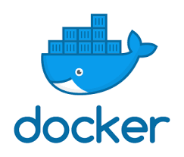
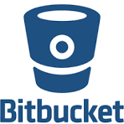

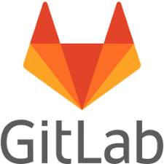

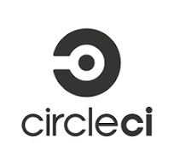




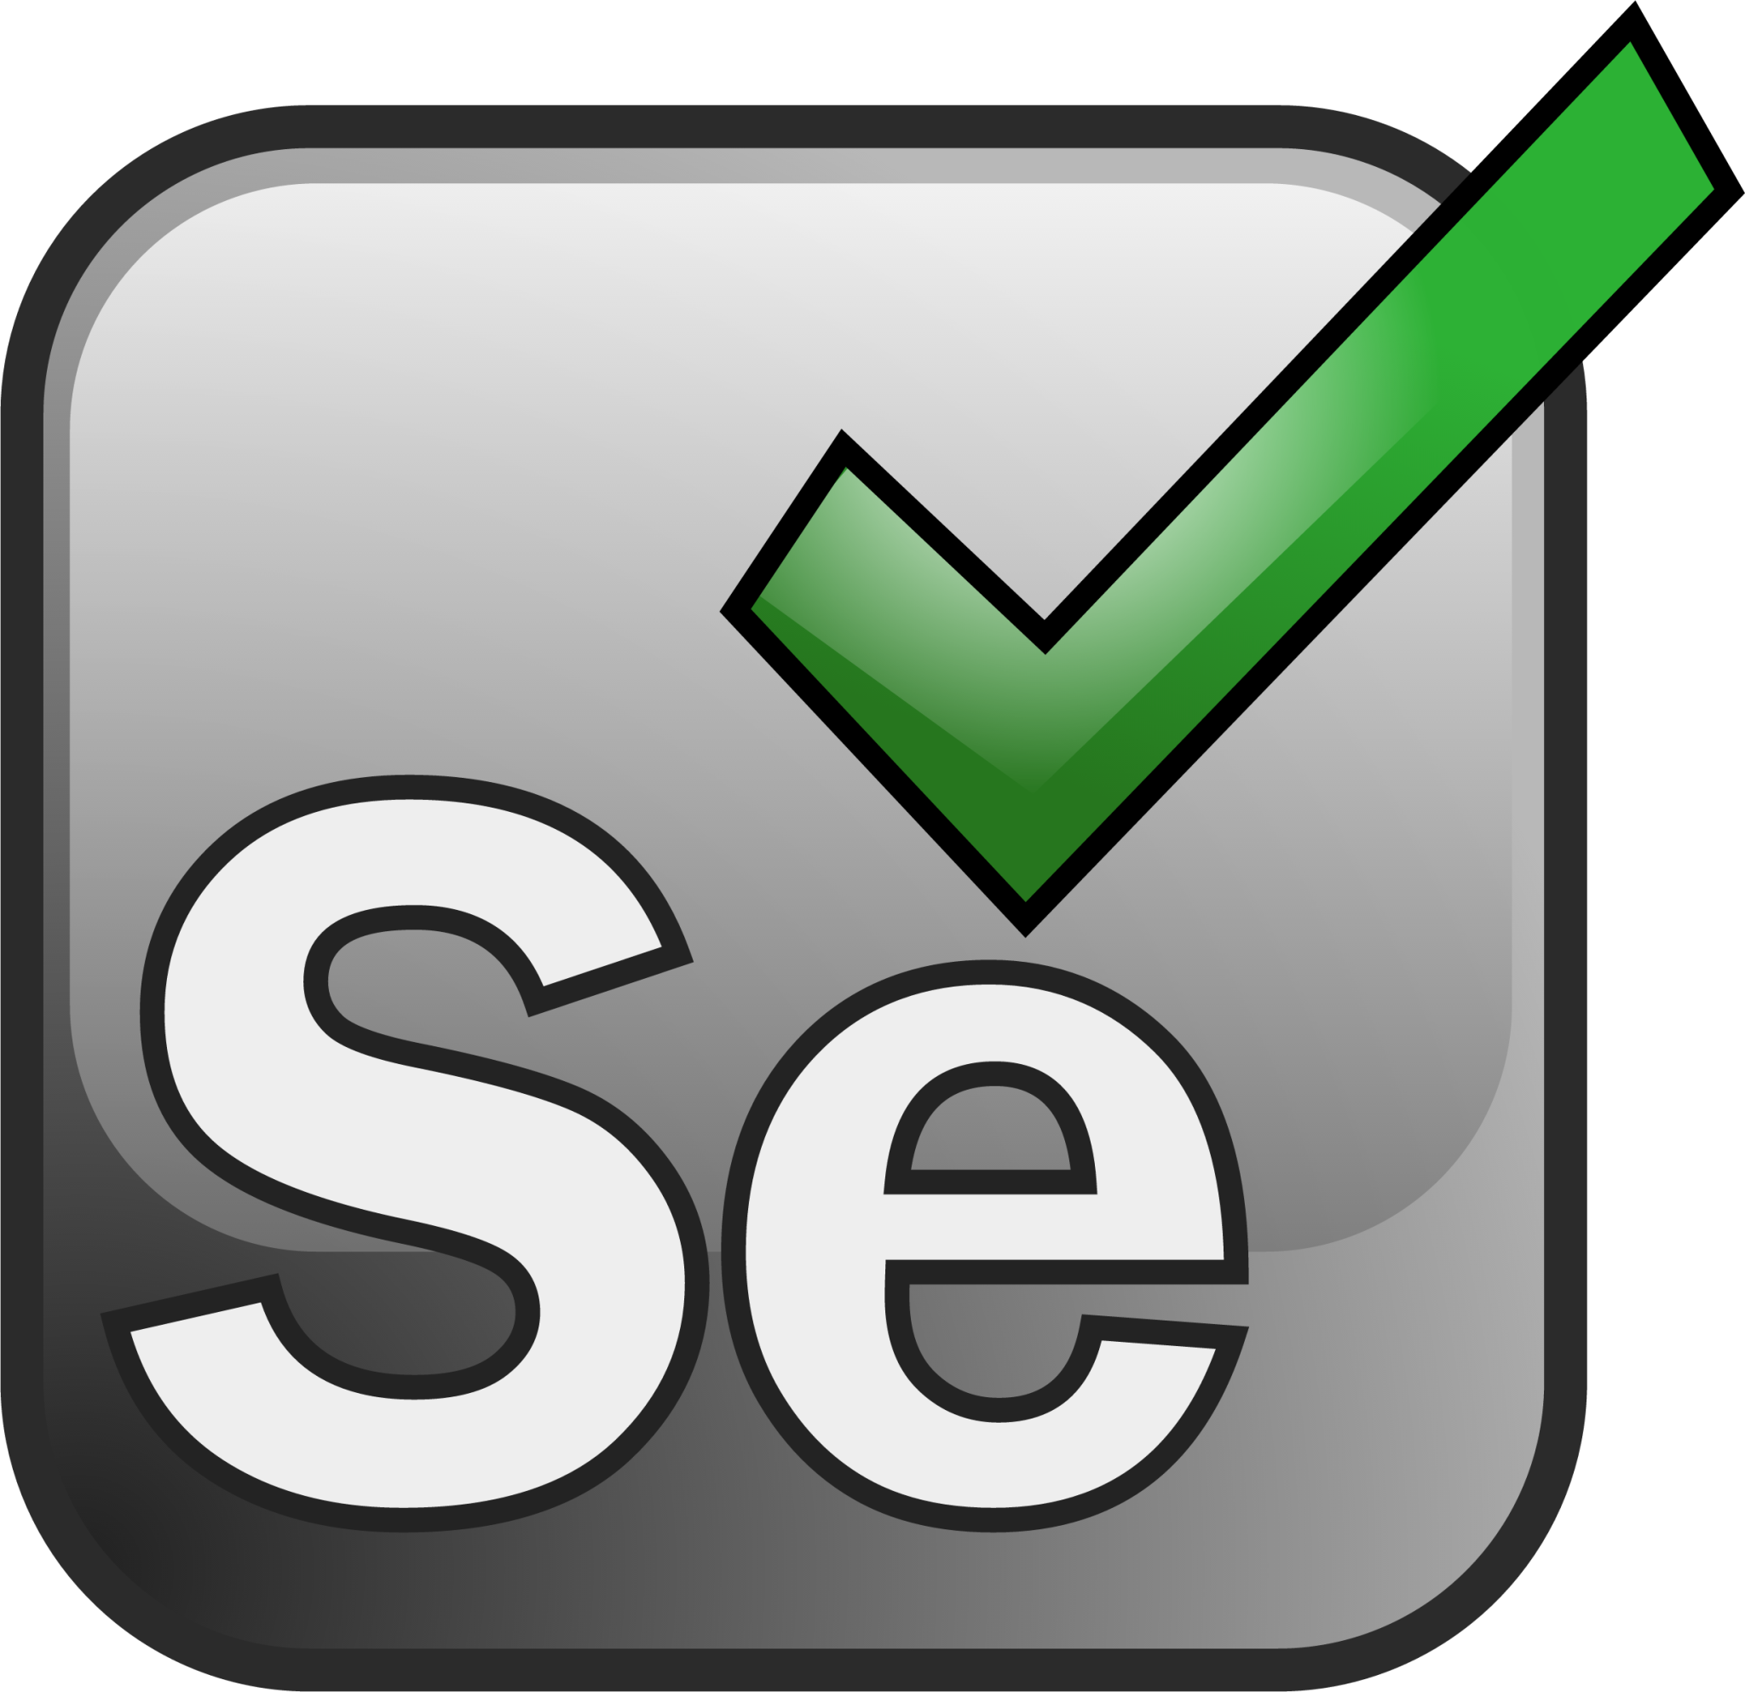



DevOps Tools
Essential tools for implementing DevOps in the software development lifecycle (SDLC) are:
Notes:
Instructor Notes:
The discussion will focus on the usage and purpose of various tools in each phase of the DevOps lifecycle, highlighting specific functionalities and benefits. Tools such as Git for version control and Prometheus for monitoring will be covered, providing a practical understanding of DevOps tooling at an appropriate depth.

Slide 34
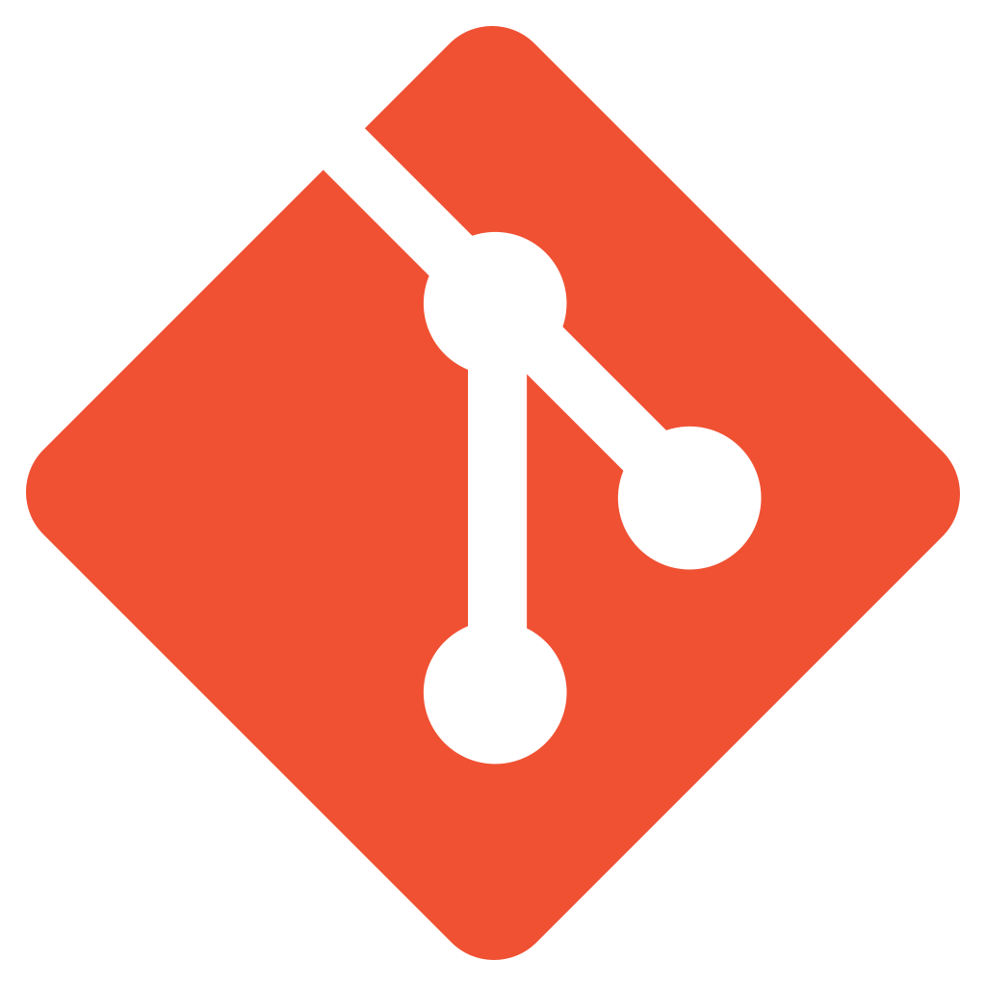

DevOps Tools
SCM tools
For source code management (SCM), version control tools such as Git, GitHub, Subversion, TFS, and Mercurial are used.
Software build tools
For automating the build process of an executable application from source code, software build tools such as Maven, Gradle, Ant, and Grunt are used.
Notes:
Instructor Notes:
SCM Tools:
Examples: Git, GitHub, Subversion, TFS, Mercurial.
Description: For source code management (SCM), version control tools such as Git, GitHub, Subversion, TFS, and Mercurial are used.
Explanation: This category includes tools that help manage changes to source code, track versions, and collaborate on code with team members.
Software Build Tools:
Examples: Maven, Gradle, Ant, Grunt.
Description: For automating the build process of an executable application from source code, software build tools such as Maven, Gradle, Ant, and Grunt are used.
Explanation: This category includes tools that automate the process of compiling source code into executable applications, managing dependencies, and packaging software.

Slide 35

DevOps Tools
Testing tools
In continuous testing phase, the built software is continuously tested for bugs using testing tools such as Selenium, TestNG, and Junit.
Integration tools
CI/CD pipelines are created for procuring updated source code and constructing the build into .exe format using tools such as Jenkins.
Notes:
Instructor Notes:
Testing Tools:
Examples: Selenium, TestNG, JUnit.
Description: In the continuous testing phase, the built software is continuously tested for bugs using testing tools such as Selenium, TestNG, and JUnit.
Explanation: This category includes tools that automate the testing process, ensuring that code changes do not introduce new bugs and that the software maintains high quality.
Integration Tools:
Examples: Jenkins
Description: CI/CD pipelines are created for procuring updated source code and constructing the build into .exe format using tools such as Jenkins.
Explanation: This category includes tools that automate the integration and deployment process, enabling continuous integration (CI) and continuous delivery (CD) by managing the build and release pipelines.

Slide 36


DevOps Tools
CMT and deployment tools
For the deployment and operations phase, CMT and automation tools such as Jenkins, AWS Code Deploy, Chef, Puppet, Ansible, and Terraform are used.
Monitoring tools
For monitoring system performance and productivity (to reduce or even eliminate downtime), monitoring tools such as Nagios, Grafana and Prometheus are used.
Notes:
Instructor Notes:
CMT and Deployment Tools:
Examples: Jenkins, AWS Code Deploy, Chef, Puppet, Ansible, Terraform.
Description: For the deployment and operations phase, CMT and automation tools such as Jenkins, AWS Code Deploy, Chef, Puppet, Ansible, and Terraform are used.
Explanation: This category includes tools that help automate the deployment process, manage configurations, and orchestrate infrastructure, ensuring consistent and reliable deployments.
Monitoring Tools:
Examples: Nagios, Grafana, Prometheus.
Description: For monitoring system performance and productivity (to reduce or even eliminate downtime), monitoring tools such as Nagios, Grafana, and Prometheus are used.
Explanation: This category includes tools that provide real-time monitoring and alerting capabilities, helping teams track system performance, detect issues, and ensure high availability.

Slide 37
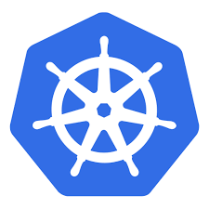
DevOps Tools
Containerization tools
For packaging an application with its required libraries, frameworks, and configuration files to efficiently run it in various computing environments, containerization tools such as Docker and Kubernetes are used.
Notes:
Instructor Notes:
Containerization Tools:
Examples: Docker, Kubernetes.
Description: For packaging an application with its required libraries, frameworks, and configuration files to efficiently run it in various computing environments, containerization tools such as Docker and Kubernetes are used.
Explanation: This category includes tools that enable the packaging and deployment of applications in a consistent and portable manner, ensuring they run reliably across different environments.

Slide 38






Companies Using DevOps
Notes:
Instructor Notes:
Though these are some major companies, provide more examples which industries and companies use DevOps

Slide 39

Case Study
Infrastructure provisioning Bottleneck (E-commerce startup)
Provisioning new infrastructure environments was a slow manual process, hindering development agility.
Maintaining consistency across development, testing, and production environments was a challenge.
Existing infrastructure struggled to handle sudden spikes in traffic during peak shopping seasons.
Challenges
Notes:
Instructor Note:
This case study will help learners understand how DevOps is adopted and what impact it has on the business

Slide 40
Case Study
Infrastructure provisioning Bottleneck (E-commerce startup)
Implemented Infrastructure as Code (IaC) using tools like Terraform. This allowed developers to define infrastructure configurations in code, enabling automated provisioning through the CI/CD pipeline.
Defined infrastructure configurations as reusable modules in IaC. These modules could be easily deployed across different environments with slight variations.
Implemented auto-scaling features in the cloud platform, which automatically scaled infrastructure resources up or down based on real-time traffic demands.
Solution
Notes:
Instructor Note:
This case study will help learners understand how DevOps is adopted and what impact it has on the business

Slide 41
Case Study
Infrastructure provisioning Bottleneck (E-commerce startup)
Faster deployment of new features and environments
Increased consistency and repeatability in infrastructure setup
Simplified environment management for developers and operations teams
Improved application performance and availability during peak traffic periods
Reduced infrastructure costs by optimizing resource utilization
Outcome
Notes:
Instructor Note:
This case study will help learners understand how DevOps is adopted and what impact it has on the business

Slide 42
Case Study
Netflix infrastructure transformation
Provisioning new infrastructure environments was a slow manual process, hindering development agility.
Maintaining consistency across development, testing, and production environments was challenging.
Existing infrastructure struggled to handle sudden spikes in traffic during peak streaming periods.
Challenges
Notes:
Instructor Note:
This case study will help learners understand how DevOps is adopted and what impact it has on the business

Slide 43
Case Study
Netflix infrastructure transformation
Adopted cloud-based infrastructure provisioning and automation tools for faster and scalable environment setup
Implemented Infrastructure as Code (IaC) practices using tools like Terraform to ensure consistency and streamline environment management
Leveraged cloud scalability to seamlessly scale resources based on demand
Solution
Notes:
Instructor Note:
This case study will help learners understand how DevOps is adopted and what impact it has on the business

Slide 44
Case Study
Netflix infrastructure transformation
Reduced provisioning time from weeks to minutes, enhancing development agility and speed of deployment
Improved environment consistency, reduced configuration errors, and increased overall efficiency in managing different environments
Improved scalability and performance during peak traffic periods, ensuring uninterrupted streaming experiences for users and mitigating infrastructure-related issues
Outcome
Notes:
Instructor Note:
This case study will help learners understand how DevOps is adopted and what impact it has on the business

Slide 45
Imagine you are tasked with ensuring smooth configuration management across development, testing, and production environments. Which tool would you select to achieve this seamlessly?
Docker
Chef
Git
Ansible
Notes:
Mode: Sync
Estimated duration: 5 minutes
Instructor Note:
Conduct the poll and, if necessary, reteach key points based on the results before starting with the next topic.
Provide feedback or explanations after the poll, where appropriate, so learners can understand why certain answers are correct or incorrect.
If most of the class is getting the poll incorrect, then there is a gap in their understanding. Prompt the learners to highlight which concepts are unclear to them and teach those topics for the understanding of the whole class. Move onto the next topic when the class is confident in their understanding of the section.
Correct Answer: D) Ansible
Explanation: Ansible is commonly used for configuration management in DevOps architecture due to its simplicity, agentless architecture, and robust automation capabilities.

Slide 46
Introduction to DevSecOps
Notes:
Instructor Notes:
Let us now introduce DevSecOps.

Slide 47


What Is DevSecOps?
It is an extension of DevOps practice that is used to automate, monitor, and apply security at all phases of the software and DevOps lifecycle.
SEC
CODE
PLAN
RELEASE
DEV
DEPLOY
OPS
OPERATE
BUILD
TEST
MONITOR
It is an approach that combines application development, security, operations and Infrastructure as Code (IaC) in an automated continuous integration and continuous delivery (CI/CD) pipeline.
Notes:
Instructor Notes:
DevSecOps (development plus security plus operations) is an approach that combines application development, security, operations and infrastructure as code (IaC) in an automated continuous integration/continuous delivery (CI/CD) pipeline.
The main objective of DevSecOps is to automate, monitor and apply security at all phases of the software lifecycle: plan, develop, build, test, release, deliver, deploy, operate and monitor. Applying security at every stage of the software development process supports CI/CD, reduces the cost of compliance and enables faster software delivery.

Slide 48
DevOps vs. DevSecOps
DevOps
DevSecOps
IT
operations
Development
IT
operations
Development
Application
delivery
Security
Application
delivery
Notes:
Instructor Notes:
DevOps Venn Diagram:
Components: Development, IT Operations, Application Delivery.
Overlap: The intersection area shows the collaboration between development, IT operations, and application delivery in the DevOps approach.
Explanation: This diagram illustrates how DevOps integrates development and operations to enhance application delivery through continuous integration, continuous delivery, and collaboration.
DevSecOps Venn Diagram:
Components: Development, IT Operations, Application Delivery, Security.
Overlap: The intersection area includes security, showing that DevSecOps incorporates security practices into the DevOps workflow.
Explanation: This diagram highlights how DevSecOps builds on DevOps by adding security as an integral part of the development and operations processes, ensuring that security is addressed throughout the development lifecycle.

Slide 49
DevOps Vs. DevSecOps
Aspect | DevOps | DevSecOps
Focus | Integrates development and operations | Extends DevOps with security practices
Key components | CI/CD pipelines and automation tools | CI/CD pipelines and security tools
Goals | Faster delivery and collaboration | Secure and efficient software delivery
Approach | Emphasizes automation and collaboration | Integrates security throughout SDLC
Security | Limited focus on security aspects | Security is integrated from the beginning
Notes:
Instructor Notes:
DevOps emphasizes collaboration between development and operations for automated software delivery, while DevSecOps integrates security practices throughout the development lifecycle alongside DevOps processes. DevSecOps ensures security is not a separate phase but part of the entire development process, with security checks and controls integrated into the CI/CD pipeline for secure software delivery. Both methodologies aim for faster delivery, reliability, and a culture of continuous improvement, with DevSecOps adding a specific focus on proactive risk management and security automation.

Slide 50
Six Pillars of DevSecOps
Collective responsibility
Implement shared responsibility to foster cohesive cloud security guided by the cloud security team
Collaboration and integration
Promote collaboration to build a security-focused culture, enhancing
teamwork and knowledge sharing in DevSecOps
Logical implementation
Utilize a versatile security model to ensure safe application development
and data integrity
Notes:
Instructor Notes:
1. Collective Responsibility
Cloud security office plays a commanding and guiding role in leveraging information security across the organization.
2. Collaboration
DevSecOps practices put much more value in security than confrontation. Therefore, you must ensure collaborative and knowledge-based culture across your organization.
3. Logical Implementation
Can use the digital security and privacy model, which is a framework agnostic one ensuring application development safety, developing integrity towards data security.

Slide 51
Six Pillars of DevSecOps
Bridging compliance and development
Address the compliance-development gap to identify necessary controls
and implement required software measures effectively
Automation
Automate security in DevSecOps to boost efficiency, reduce workloads,
ensure quality checks, and cut labor costs
Measure, manage, and execute
Manage security tasks skillfully during both development and
post-delivery phases
Notes:
Instructor Notes:
4. Bridging gap between compliance and development
The reason behind addressing the compliance and development gap is to find out suitable controls necessary to translate into required software measures.
5. Automation
Automated security processes can bring better efficiency, reduced workloads, and regular quality checks across the production pipeline. It also cuts the extra labour costs.
6. Measure, Manage, Address, and Execute
The software development-related, and post-delivery related results must be measured, managed, addressed, and executed by skilled and expert people.

Slide 52


OWASP DevSecOps Guidelines
It provides a roadmap for incorporating security measures throughout the DevOps process, promoting a culture of security and collaboration.
Secret
Scanning
SCA
SAST
IaC
Scanning
Container
Scanning
DAST
Infra
Scanning
Compliance
Check/PaC
Roadmap for implementing a basic pipeline
Notes:
Instructor Notes:
Scan git repositories: Identifying potential credentials leakage.
SAST (Static Application Security Test): Analyzing code for security vulnerabilities.
SCA (Software Composition Analysis): Identifying and managing third-party component vulnerabilities.
IAST (Interactive Application Security Testing): Evaluating application security during runtime.
DAST (Dynamic Application Security Test): Testing application security through simulated attacks.
IaC Scanning: Checking Terraform and HelmChart code for misconfigurations.
Infrastructure scanning: Assessing infrastructure components for security risks.
Compliance check: Ensuring adherence to security and regulatory standards.

Slide 53
OWASP DevSecOps Guidelines
SAST (Static Application Security Test)
Identify vulnerabilities in source code through static analysis without executing
the program
SCA (Software Composition Analysis)
Manage and assess open-source components for security risks and
compliance issues
IAST (Interactive Application Security Testing)
Test real-time applications during runtime to detect vulnerabilities
DAST (Dynamic Application Security Test)
Assess web applications in an active state to uncover vulnerabilities and
security weaknesses
Notes:
Instructor Notes:
SAST (Static Application Security Test): Static analysis of source code to identify security vulnerabilities without executing the program.
SCA (Software Composition Analysis): Identifying and managing open-source components and their dependencies for security vulnerabilities and licensing compliance.
IAST (Interactive Application Security Testing): Combines elements of SAST and DAST by testing applications for vulnerabilities during runtime.
DAST (Dynamic Application Security Test): Evaluating web applications in an operating state to detect vulnerabilities and potential security issues.

Slide 54
OWASP DevSecOps Guidelines
IaC scanning
Examine Infrastructure as Code (IaC) files like Terraform or Helm Charts to detect
configuration errors and security gaps
Infrastructure scanning
Evaluate the security status of infrastructure components like servers, networks,
and databases for potential vulnerabilities
Compliance check
Ensure systems and applications adhere to regulatory and industry-specific
security standards and guidelines
Notes:
Instructor Notes:
IaC Scanning: Analyzing Infrastructure as Code (IaC) files like Terraform or Helm Charts to detect misconfigurations and security flaws.
Infrastructure scanning: Assessing the security posture of infrastructure components such as servers, networks, and databases for vulnerabilities.
Compliance check: Ensuring systems and applications adhere to regulatory and industry-specific security standards and guidelines.

Slide 55


DevSecOps Architecture
It is the design and implementation of integrated security practices within the software development and deployment pipeline.
Below is the architecture of DevSecOps based on security aspects:
Continuous integration
Continuous deployment
Compliance and governance
Repository
Automated test-unit test
Component
Library
Package
Automated compliance audit
Secure code scan
Infrastructure as Code (IaC) (Provisioning)
Analyst
Release coordination
Build process
Secure component scan
Configuration management
Environment monitoring
Secure application scan
Target Environment
Developer
Source control management
Application deployment
Deployment governance
DEV
QA
INT
PRD
Notes:
Instructor Notes:
DevSecOps architecture refers to the design and structure of an integrated approach that combines development, security, and operations practices within the software development lifecycle (SDLC). It involves incorporating security measures, tools, and processes throughout the development pipeline to ensure that security is not an afterthought but an integral part of the entire software development and deployment process.

Slide 56
DevSecOps Architecture
Security aspects in all the three phases of DevSecOps architecture:
Continuous integration (CI)
Continuous deployment (CD)
Continuous compliance (CC)
Automates the process of integrating code changes from multiple developers, fostering early detection of security vulnerabilities through integration testing
Streamlines the deployment process, enabling frequent release of secure code by incorporating security checks throughout the deployment pipeline
Ensures ongoing adherence to security regulations, by automating security scans and enforcing compliance policies throughout the development lifecycle
Notes:
Instructor Notes:
Continuous Integration (CI):
Secure Code Reviews: Integrate static code analysis tools into the CI pipeline to identify potential vulnerabilities and security flaws early in the development process.
Secure Dependency Management: Use a dependency management tool that scans libraries and frameworks for known vulnerabilities before integration.
Secret Scanning: Prevent accidental exposure of sensitive data (passwords, API keys) by scanning code for these secrets before committing or deploying.
Access Control: Implement access controls within the CI environment to restrict who can push code and manage pipelines.
Continuous Deployment (CD):
Immutable Infrastructure: Deploy applications to new environments instead of modifying existing ones. This ensures a clean and secure state with every deployment.
Least Privilege: Grant deployments the minimum permissions required to function, reducing the attack surface in case of a breach.
Security Testing: Integrate security testing tools into the CD pipeline to identify vulnerabilities before deployment to production.
Continuous Compliance (CC):
Policy as Code: Define security and compliance policies as code within the CI/CD workflow. This allows for automated enforcement and verification.
Configuration Management: Use configuration management tools to ensure all systems in the deployment environment are configured securely and consistently.
Vulnerability Scanning: Regularly scan deployed applications for vulnerabilities and security misconfigurations.
Compliance Reporting: Automatically generate reports to demonstrate adherence to security and compliance regulations.

Slide 57
DevSecOps Architecture
Security aspects in all the three phases of DevSecOps architecture:
Continuous integration (CI)
Continuous deployment (CD)
Continuous compliance (CC)
Secure code reviews
Secure dependency management
Secret scanning
Access control
Immutable infrastructure
Least privilege
Security testing
Policy as code
Configuration management
Vulnerability scanning
Compliance reporting
Notes:
Instructor Notes:
Continuous Integration (CI):
Secure Code Reviews: Integrate static code analysis tools into the CI pipeline to identify potential vulnerabilities and security flaws early in the development process.
Secure Dependency Management: Use a dependency management tool that scans libraries and frameworks for known vulnerabilities before integration.
Secret Scanning: Prevent accidental exposure of sensitive data (passwords, API keys) by scanning code for these secrets before committing or deploying.
Access Control: Implement access controls within the CI environment to restrict who can push code and manage pipelines.
Continuous Deployment (CD):
Immutable Infrastructure: Deploy applications to new environments instead of modifying existing ones. This ensures a clean and secure state with every deployment.
Least Privilege: Grant deployments the minimum permissions required to function, reducing the attack surface in case of a breach.
Security Testing: Integrate security testing tools into the CD pipeline to identify vulnerabilities before deployment to production.
Continuous Compliance (CC):
Policy as Code: Define security and compliance policies as code within the CI/CD workflow. This allows for automated enforcement and verification.
Configuration Management: Use configuration management tools to ensure all systems in the deployment environment are configured securely and consistently.
Vulnerability Scanning: Regularly scan deployed applications for vulnerabilities and security misconfigurations.
Compliance Reporting: Automatically generate reports to demonstrate adherence to security and compliance regulations.

Slide 58
Best Practices in DevSecOps
Shift left
Foster
collaboration
Adopt
automation
Implement security practices early in development process to enhance security posture from the outset
Promote shared responsibility and collaboration for effective outcomes across teams
Automate CI/CD with integrated security for rapid and consistent software delivery
Notes:
Instructor Notes:
Shift left: This means that security practices are implemented earlier in the development process, right from the design stage.
Foster a culture of collaboration: The development, security and operations teams should be aware of their shared responsibility and be encouraged to collaborate and share skills and knowledge.
Adopt automation: The entire CI/CD pipeline should be automated to enable the rapid and consistent delivery of software, with a security check at every stage.

Slide 59
Best Practices in DevSecOps
Prioritize risk management
Enforce access controls
Emphasize the importance of managing risk by implementing
essential security controls to mitigate potential threats effectively
Apply role-based access controls for comprehensive security during development
Notes:
Instructor Notes:
Prioritize risk management: DevSecOps teams that make risk management their priority ensure that security controls are implemented, and risks reduced.
Enforce access controls: Access controls such as least-privilege principles and role-based access controls should be implemented throughout the development process to protect sensitive data and systems.

Slide 60
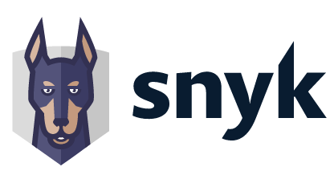


DevSecOps Tools
DevSecOps tools assist in early identification of security vulnerabilities during development.
Snyk is a developer-focused security platform that scans code and dependencies for vulnerabilities, providing actionable insights and recommendations for secure coding practices and container security.
OWASP ZAP (Zed Attack Proxy) is a user-friendly, open-source DAST tool for web applications, offering manual and automated scanning to detect vulnerabilities like SQL injection and XSS.
SonarQube is an open-source tool for continuous code quality and security inspection, seamlessly integrated into CI/CD pipelines, supporting multiple languages with static code analysis and vulnerability detection.
Notes:
Instructor Notes:
Tool: Snyk
Description: "Snyk is a developer-focused security platform that scans code and dependencies for vulnerabilities, providing actionable insights and recommendations for secure coding practices and container security."
Explanation: Highlight Snyk's role in scanning for vulnerabilities in code and dependencies, providing developers with insights and recommendations to enhance security.
Tool: OWASP ZAP (Zed Attack Proxy)
Description: "OWASP ZAP (Zed Attack Proxy) is a user-friendly, open-source DAST tool for web applications, offering manual and automated scanning to detect vulnerabilities like SQL injection and XSS."
Explanation: Explain OWASP ZAP's functionality as a dynamic application security testing (DAST) tool, capable of detecting common web application vulnerabilities through both manual and automated scans.
Tool: SonarQube
Description: "SonarQube is an open-source tool for continuous code quality and security inspection, seamlessly integrated into CI/CD pipelines, supporting multiple languages with static code analysis and vulnerability detection."
Explanation: Describe SonarQube's capabilities in providing continuous code quality and security inspection through static code analysis, integrating smoothly with CI/CD pipelines.

Slide 61

Case Study
Secure software delivery: DevSecOps implementation at PayPal
PayPal faced challenges in ensuring secure software delivery due to increasing cyber threats and compliance requirements.
Traditional methods were inadequate to handle the fast-evolving vulnerabilities in their software.
The challenge is implementing an integrated and automated security approach across the development cycle to address coordination issues in app development with multiple team members.
Challenges
Notes:
Instructor Notes:
This case study will help learners understand how DevSecOps is adopted and what impact it has on the business

Slide 62
Case Study
Secure software delivery: DevSecOps implementation at PayPal
PayPal adopted DevSecOps, integrating security into the software delivery pipeline with automation tools for testing and compliance.
They enforced secure coding guidelines and promoted better team collaboration to share security responsibilities.
This streamlined security practices and enhanced software resilience by making security an integral part of the development process.
Solution
Notes:
Instructor Notes:
This case study will help learners understand how DevSecOps is adopted and what impact it has on the business

Slide 63
Case Study
Secure software delivery: DevSecOps implementation at PayPal
Enhanced security posture through early vulnerability detection
Accelerated software delivery with automated testing
Reduced security risks (due to adherence to regulatory compliance)
Decreased security incidents and vulnerabilities
Outcome
Notes:
Instructor Notes:
This case study will help learners understand how DevSecOps is adopted and what impact it has on the business

Slide 64

Case Study
Securing digital operations: DevSecOps implementation at Allianz
Allianz faced cybersecurity challenges endangering customer data and financial systems.
Traditional security methods were insufficient against evolving threats.
Lack of teamwork between development and operations teams caused delays, urging a more integrated approach.
Challenges
Notes:
Instructor Notes:
This case study will help learners understand how DevSecOps is adopted and what impact it has on the business

Slide 65
Case Study
Securing digital operations: DevSecOps implementation at Allianz
Allianz adopted DevSecOps to integrate security into development and operations, fostering teamwork and automating security checks.
They implemented automated security checks throughout the software development stages.
Employees were trained in secure coding practices as part of their DevSecOps initiatives.
Solution
Notes:
Instructor Notes:
This case study will help learners understand how DevSecOps is adopted and what impact it has on the business

Slide 66
Case Study
Securing digital operations: DevSecOps implementation at Allianz
Enhanced security posture through early vulnerability detection with DevSecOps
Automated feature deployment to ensure security and compliance standards
Improved collaboration for better operational efficiency
Continuous improvement through feedback loops and metrics
Outcome
Notes:
Instructor Notes:
This case study will help learners understand how DevSecOps is adopted and what impact it has on the business

Slide 67
As a DevOps lead in the team, how would you define the shifting left approach in DevSecOps and its significance in ensuring early security considerations within the development processes?
Delaying security checks until deployment
Including security practices early in the development process
Focusing only on operational security
Ignoring security concerns
Notes:
Mode: Sync
Estimated duration: 5 minutes
Instructor Notes:
Conduct the poll and, if necessary, reteach key points based on the results before starting with the next topic.
Provide feedback or explanations after the poll, where appropriate, so learners can understand why certain answers are correct or incorrect.
If most of the class is getting the poll incorrect, then there is a gap in their understanding. Prompt the learners to highlight which concepts are unclear to them and teach those topics for the understanding of the whole class. Move onto the next topic when the class is confident in their understanding of the section.
Correct Answer: B) Including security practices early in the development process
Explanation: Shifting left in DevSecOps refers to integrating security considerations early in the development phase rather than addressing them later in the deployment or production stages.

Slide 68
The aim of DevOps is to shrink the development cycle and ensure continuous delivery of high-quality software.
Agile is an iterative development process that promotes continuous iteration of development.
The lifecycle of DevOps streamlines software development in seven phases, starting with planning and progressing to speed up the process.
The main objective of DevSecOps is to automate, monitor, and apply security at all phases of the software lifecycle.
DevSecOps tools assist in early identification of security vulnerabilities during development.
Notes:
Mode: Sync
Estimated duration: 5 mins
Type: Instructor-led activity

Slide 69
Thank You

